Slide 1


Cdr Vijay Pratap Singh,
Adjunct Professor, E&TC, TCET

Slide 2

The concept of job enrichment was developed by Fredrik Herzberg in the 1950s.
Job enrichment involves providing an employee with more responsibility for a job and challenges the individual’s skills at work.
Enrichment involves increasing the decision-making authority and encouraging the employee with their tasks.

Slide 3
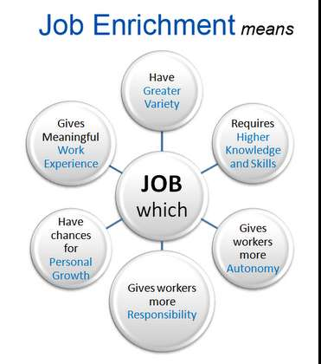

Slide 4



The characteristics or features of job enrichment are:-
Nature of Job : Job enrichment is a vertical expansion of the job.
Objective : The objective of Job enrichment is to make the job more lively and challenging.

Slide 5

Positive Results : Job enrichment gives positive results if the workers are highly skilled.
Direction and Control : Job enrichment encourages self- discipline.

Slide 6




The importance or merits or advantages of job-enrichment are:-
Job enrichment is useful to both the workers and the organization.
The worker gets achievement, recognition and self-actualization.
The worker gets a sense of belonging to the organization.
The worker finds the job meaningful.
Job enrichment reduces absenteeism, labour-turnover and grievances.
It motivates the workers to give best performance.

Slide 7



The shortcomings or demerits or limitations of job enrichment are:-
In many cases, job enrichment does not give the expected results.
It makes many changes in the job. So many workers oppose it.
It has limited use for highly skilled managers and professionals.
The consent of workers is not taken before implementing job enrichment.
Managers force the workers to accept job enrichment, which is not good.

Slide 8


Some strategies you can use to enrich jobs in your workplace:
Rotate Jobs -Give people the opportunity to use a variety of skills, and perform different kinds of work.
Combine Tasks -Combine work activities to provide a more challenging and complex work assignment.

Slide 9
Identify Project-Focused Work Units – Break your typical functional lines and form project-focused units. Create Autonomous Work Teams – This is job enrichment at the group level. Implement Participative Management – Allow team members to participate in decision making and get involved in strategic planning

Slide 10
Redistribute Power and Authority – Redistribute control and grant more authority to workers for making job-related decisions.
Increase Employee-Directed Feedback – Make sure that people know how well, or poorly, they're performing their jobs.

Slide 11




Step One – Find out where people are dissatisfied with their current work assignments.
Step Two – Consider which job enrichment options you can provide.
Step Three – Design and communicate your program.

Slide 12


Job enrichment is a fundamental part of attracting, motivating, and
retaining talented people, particularly where work is repetitive or boring.
To do it well, you need a great match between the way your jobs are
designed and the skills and interests of the employees working for you.

Slide 13


